Slide 1


UNIVERSITY INSTITUTE OF ENGINEERING
Bachelor of Engineering (Computer Science & Engineering)
Operating System (CST-328)
Subject Coordinator: Er. Puneet kaur(E6913)
Deadlocks
DISCOVER . LEARN . EMPOWER

Slide 2
Lecture 11 Deadlocks List-of-content Deadlocks: Deadlock avoidance-safe state, Banker’s algorithms-Safety algorithm

Slide 4
Deadlock Avoidance
This strategy involves maintaining a set of data using which a decision is made whether to entertain the new request or not.
If entertaining the new request causes the system to move in an unsafe state, then it is discarded.
This strategy requires that every process declares its maximum requirement of each resource type in the beginning.
The main challenge with this approach is predicting the requirement of the processes before execution.
Banker’s Algorithm is an example of a deadlock avoidance strategy.

Slide 5
Safe State
When a process requests an available resource, system must decide if immediate allocation leaves the system in a safe state
System is in safe state if there exists a sequence <P₁, P₂, …, P_{n}> of ALL the processes in the systems such that for each P_{i}, the resources that P_{i} can still request can be satisfied by currently available resources + resources held by all the P_{j}, with j < I
That is:
If P_{i} resource needs are not immediately available, then P_{i} can wait until all P_{j} have finished
When P_{j} is finished, P_{i} can obtain needed resources, execute, return allocated resources, and terminate
When P_{i} terminates, P_{i +1} can obtain its needed resources, and so on

Slide 6
Basic Facts
If a system is in safe state ⇒ no deadlocks
If a system is in unsafe state ⇒ possibility of deadlock
Avoidance ⇒ ensure that a system will never enter an unsafe state.

Slide 7
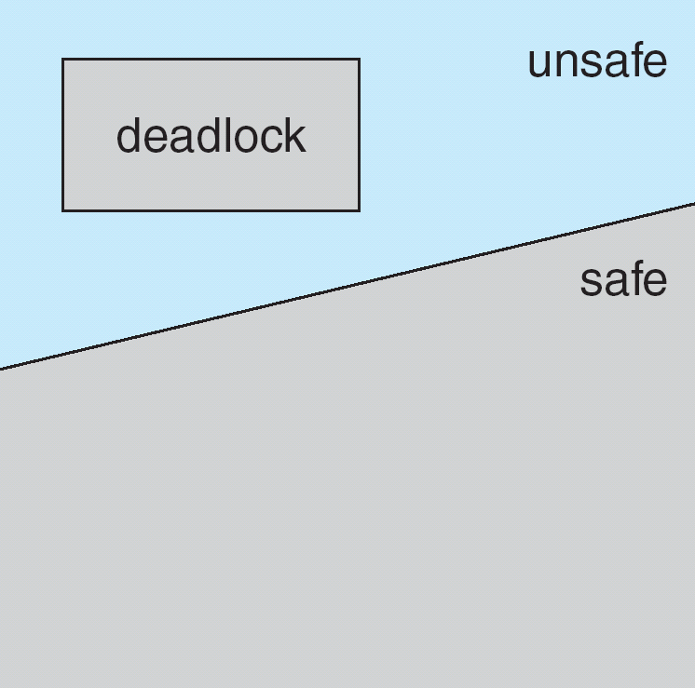
Safe, Unsafe, Deadlock State

Slide 8
Deadlock Avoidance Algorithms
Single instance of a resource type
Use a resource-allocation graph
Multiple instances of a resource type
Use the banker’s algorithm

Slide 9
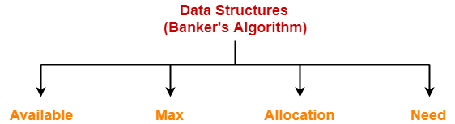
Banker’s Algorithm
Banker’s Algorithm is a deadlock avoidance strategy.
It is called so because it is used in banking systems to decide whether a loan can be granted or not.
Banker’s Algorithm requires whenever a new process is created, it specifies the maximum number of instances of each resource type that it exactly needs.
To implement banker’s algorithm, following four data structures are used-

Slide 10
Data Structures for the Banker’s Algorithm
Let n = number of processes, and m = number of resources types.
Available: Vector of length m. If available [j] = k, there are k instances of resource type Rj available.
Max: n x m matrix. If Max [i,j] = k, then process Pi may request at most k instances of resource type Rj.
Allocation: n x m matrix. If Allocation[i,j] = k then Pi is currently allocated k instances of Rj.
Need: n x m matrix. If Need[i,j] = k, then Pi may need k more instances of Rj to complete its task.
Need [i,j] = Max[i,j] – Allocation [i,j].

Slide 11
Working
Step-01:
Banker’s Algorithm checks whether the request made by the process is valid or not.
A request is considered valid if and only if-
The number of requested instances of each resource type is less than the need declared by the process in the beginning.
If the request is invalid, it aborts the request.
If the request is valid, it follows step-02.
Step-02:
Banker’s Algorithm checks if the number of requested instances of each resource type is less than the number of available instances of each type.
If the sufficient number of instances are not available, it asks the process to wait longer.
If the sufficient number of instances are available, it follows step-03.

Slide 12
Working
Step-03:
Banker’s Algorithm makes an assumption that the requested resources have been allocated to the process.
Then, it modifies its data structures accordingly and moves from one state to the other state.
Available = Available - Request(i)
Allocation(i) = Allocation(i) + Request(i)
Need(i) = Need(i) - Request(i)
Now, Banker’s Algorithm follows the safety algorithm to check whether the resulting state it has entered in is a safe state or not.
If it is a safe state, then it allocates the requested resources to the process in actual.
If it is an unsafe state, then it rollbacks to its previous state and asks the process to wait longer.

Slide 13
Safety Algorithm
Safety Algorithm is executed to check whether the resultant state after allocating the resources is safe or not.
When a process gets all its resources it must return them in a finite amount of time. Let Work and Finish be vectors of length m and n, respectively. Initialize:
Work = Available
Finish [i] = false for i - 1,3, …, n.
Find an i such that both:
Finish [i] = false
Need_{i} <= Work
If no such i exists, go to step 4.

Slide 14
Safety Algorithm
Work = Work + Allocation_{i}
Finish[i] = true
go to step 2.
If Finish [i] == true for all i, then the system is in a safe state.

Slide 15
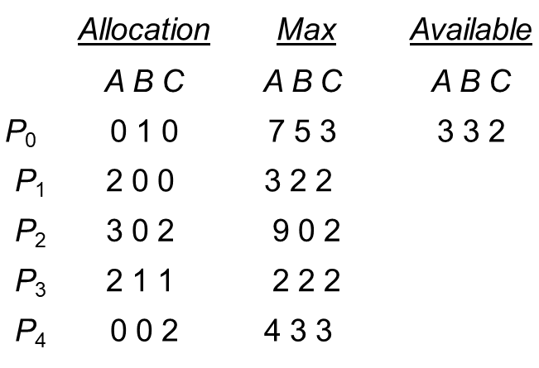
Example of Banker’s Algorithm
5 processes P₀ through P₄; 3 resource types A(10 instances), B (5instances, and C (7 instances).
Snapshot at time T₀:

Slide 16
Example (Cont.)
The content of the matrix. Need is defined to be Max – Allocation.
Need
A B C
P₀ | 7 4 3
P₁ | 1 2 2
P₂ | 6 0 0
P₃ | 0 1 1
P₄ | 4 3 1
The system is in a safe state since the sequence < P1, P3, P4, P2, P0> satisfies safety criteria.

Slide 17
Example P1 Request (1,0,2) (Cont.)
Check that Request ≤ Available (that is, (1,0,2) ≤ (3,3,2) ⇒ true.
 | Allocation | Need | Available
 | A B C | A B C | A B C
P₀ | 0 1 0 | 7 4 3 | 2 3 0
P₁ | 3 0 2 | 0 2 0
P₂ | 3 0 1 | 6 0 0
P₃ | 2 1 1 | 0 1 1
P₄ | 0 0 2 | 4 3 1

Slide 18
Example P1 Request (1,0,2) (Cont.)
Executing safety algorithm shows that sequence <P1, P3, P4, P0, P2> satisfies safety requirement.
Can request for (3,3,0) by P4 be granted?
Can request for (0,2,0) by P0 be granted?

Slide 19
Example P1 Request (1,0,2) (Cont.)
Executing safety algorithm shows that sequence <P1, P3, P4, P0, P2> satisfies safety requirement.
Can request for (3,3,0) by P4 be granted?
Can request for (0,2,0) by P0 be granted?

Slide 20
Problem-01
A single processor system has three resource types X, Y and Z, which are shared by three processes. There are 5 units of each resource type. Consider the following scenario, where the column alloc denotes the number of units of each resource type allocated to each process, and the column request denotes the number of units of each resource type requested by a process in order to complete execution. Which of these processes will finish LAST?
Option 1. P0
Option 2. P1
Option 3. P2
Option 4. None of the above since the system is in a deadlock

Slide 21
Problem-01 cont…
 | Alloc |  |  | Request
 | X | Y | Z | X | Y | Z
P0 | 1 | 2 | 1 | 1 | 0 | 3
P1 | 2 | 0 | 1 | 0 | 1 | 2
P2 | 2 | 2 | 1 | 1 | 2 | 0

Slide 22
Solution
According to question-
Total = [ X Y Z ] = [ 5 5 5 ]
Total _Alloc = [ X Y Z ] = [5 4 3]
Now,
Available
= Total – Total_Alloc
= [ 5 5 5 ] – [5 4 3]
= [ 0 1 2 ]

Slide 23
Solution
Step-01:
With the instances available currently, only the requirement of the process P1 can be satisfied.
So, process P1 is allocated the requested resources.
It completes its execution and then free up the instances of resources held by it.
Then,
Available
= [ 0 1 2 ] + [ 2 0 1]
= [ 2 1 3 ]

Slide 24
Solution
Step-02:
With the instances available currently, only the requirement of the process P0 can be satisfied.
So, process P0 is allocated the requested resources.
It completes its execution and then free up the instances of resources held by it.
Then-
Available
= [ 2 1 3 ] + [ 1 2 1 ]
= [ 3 3 4 ]

Slide 25
Solution
Step-03:
With the instances available currently, the requirement of the process P2 can be satisfied.
So, process P2 is allocated the requested resources.
It completes its execution and then free up the instances of resources held by it.
Then Available = [ 3 3 4 ] + [ 2 2 1 ]= [ 5 5 5 ]
Thus,
There exists a safe sequence P1, P0, P2 in which all the processes can be executed.
So, the system is in a safe state.
Process P2 will be executed at last.
Thus, Option (3) is correct.

Slide 26
Problem-02
An operating system uses the banker’s algorithm for deadlock avoidance when managing the allocation of three resource types X, Y and Z to three processes P0, P1 and P2. The table given below presents the current system state. Here, the Allocation matrix shows the current number of resources of each type allocated to each process and the Max matrix shows the maximum number of resources of each type required by each process during its execution.
 | Allocation |  |  | Max
 | X | Y | Z | X | Y | Z
P0 | 0 | 0 | 1 | 8 | 4 | 3
P1 | 3 | 2 | 0 | 6 | 2 | 0
P2 | 2 | 1 | 1 | 3 | 3 | 3

Slide 27
Problem-02 cont…
There are 3 units of type X, 2 units of type Y and 2 units of type Z still available. The system is currently in safe state. Consider the following independent requests for additional resources in the current state-
REQ1: P0 requests 0 units of X, 0 units of Y and 2 units of Z
REQ2: P1 requests 2 units of X, 0 units of Y and 0 units of Z
Which of the following is TRUE?
1. Only REQ1 can be permitted
2. Only REQ2 can be permitted
3. Both REQ1 and REQ2 can be permitted
4. Neither REQ1 nor REQ2 can be permitted

Slide 28
Solution
According to question,
Available = [ X Y Z ] = [ 3 2 2 ]
Now,
Need = Max – Allocation
So, we have-
 | Allocation |  |  | Max |  |  | Need
 | X | Y | Z | X | Y | Z | X | Y | Z
P0 | 0 | 0 | 1 | 8 | 4 | 3 | 8 | 4 | 2
P1 | 3 | 2 | 0 | 6 | 2 | 0 | 3 | 0 | 0
P2 | 2 | 1 | 1 | 3 | 3 | 3 | 1 | 2 | 2

Slide 29
Solution
Checking Whether REQ1 Can Be Entertained-
Need of P0 = [ 0 0 2 ]
Available = [ 3 2 2 ]
Clearly,
With the instances available currently, the requirement of REQ1 can be satisfied.
So, banker’s algorithm assumes that the request REQ1 is entertained.
It then modifies its data structures as-

Slide 30
Solution
 | Allocation |  |  | Max |  |  | Need
 | X | Y | Z | X | Y | Z | X | Y | Z
P0 | 0 | 0 | 3 | 8 | 4 | 3 | 8 | 4 | 0
P1 | 3 | 2 | 0 | 6 | 2 | 0 | 3 | 0 | 0
P2 | 2 | 1 | 1 | 3 | 3 | 3 | 1 | 2 | 2

Slide 31
Solution
Available= [ 3 2 2 ] – [ 0 0 2 ]= [ 3 2 0 ]
Now, it follows the safety algorithm to check whether this resulting state is a safe state or not.
If it is a safe state, then REQ1 can be permitted otherwise not.
Step-01:
With the instances available currently, only the requirement of the process P1 can be satisfied.
So, process P1 is allocated the requested resources.
It completes its execution and then free up the instances of resources held by it.
Then Available= [ 3 2 0 ] + [ 3 2 0 ]= [ 6 4 0 ]
Now,
It is not possible to entertain any process.
The system has entered the deadlock state which is an unsafe state.
Thus, REQ1 will not be permitted.

Slide 32
Solution
Checking Whether REQ2 Can Be Entertained-
Need of P1 = [ 2 0 0 ]
Available = [ 3 2 2 ]
Clearly,
With the instances available currently, the requirement of REQ1 can be satisfied.
So, banker’s algorithm assumes the request REQ2 is entertained.
It then modifies its data structures as-

Slide 33
Solution
 | Allocation |  |  | Max |  |  | Need
 | X | Y | Z | X | Y | Z | X | Y | Z
P0 | 0 | 0 | 1 | 8 | 4 | 3 | 8 | 4 | 2
P1 | 5 | 2 | 0 | 6 | 2 | 0 | 1 | 0 | 0
P2 | 2 | 1 | 1 | 3 | 3 | 3 | 1 | 2 | 2

Slide 34
Solution
Available
= [ 3 2 2 ] – [ 2 0 0 ] = [ 1 2 2 ]
Now, it follows the safety algorithm to check whether this resulting state is a safe state or not.
If it is a safe state, then REQ2 can be permitted otherwise not.
Step-01:
With the instances available currently, only the requirement of the process P1 can be satisfied.
So, process P1 is allocated the requested resources.
It completes its execution and then free up the instances of resources held by it.
Then-
Available
= [ 1 2 2 ] + [ 5 2 0 ]
= [ 6 4 2 ]

Slide 35
Solution
Step-02:
With the instances available currently, only the requirement of the process P2 can be satisfied.
So, process P2 is allocated the requested resources.
It completes its execution and then free up the instances of resources held by it.
Then-
Available
= [ 6 4 2 ] + [ 2 1 1 ]
= [ 8 5 3 ]

Slide 36
Solution
Step-03:
With the instances available currently, the requirement of the process P0 can be satisfied.
So, process P0 is allocated the requested resources.
It completes its execution and then free up the instances of resources held by it.
Then-
Available = [ 8 5 3 ] + [ 0 0 1 ]= [ 8 5 4 ]
Thus,
There exists a safe sequence P1, P2, P0 in which all the processes can be executed.
So, the system is in a safe state.
Thus, REQ2 can be permitted.
Thus, Correct Option is (B).

Slide 37
Conclusion
This lecture enables you to have a deep insight to Deadlock avoidance, a safe state, Banker’s algorithms and Safety algorithm to avoid deadlock.

Slide 38
References
https://www.includehelp.com/c-programming-questions/
https://www.studytonight.com/operating-system/
https://computing.llnl.gov/tutorials/
https://www.tutorialspoint.com/operating_system/index.htm#:~:text=An%20operating%20system%20(OS)%20is,software%20in%20a%20computer%20system.
https://www.javatpoint.com/os-tutorial
https://www.guru99.com/operating-system-tutorial.html
https://www.geeksforgeeks.org/operating-systems/

